Slide 1
Artificial Intelligence
Unit II

Slide 2
Adversarial Search(Game Theory)
Adversarial search is a search, where we examine the problem which arises when we try to plan ahead of the world and other agents are planning against us.
There might be some situations where more than one agent is searching for the solution in the same search space, and this situation usually occurs in game playing.
The environment with more than one agent is termed as multi-agent environment, in which each agent is an opponent of other agent and playing against each other. Each agent needs to consider the action of other agent and effect of that action on their performance.
So, Searches in which two or more players with conflicting goals are trying to explore the same search space for the solution, are called adversarial searches, often known as Games.

Slide 3
Min Max Algorithm
Minimax is an algorithm that is used in decision making and game theory to find the optimal move for a player, assuming that your opponent also plays optimally.
It is widely used in two player turn-based games such as Tic-Tac-Toe, Chess, etc.
In Minimax the two players are called maximizer and minimizer.
The maximizer tries to get the highest score possible while the minimizer tries to do the opposite and get the lowest score possible.

Slide 4
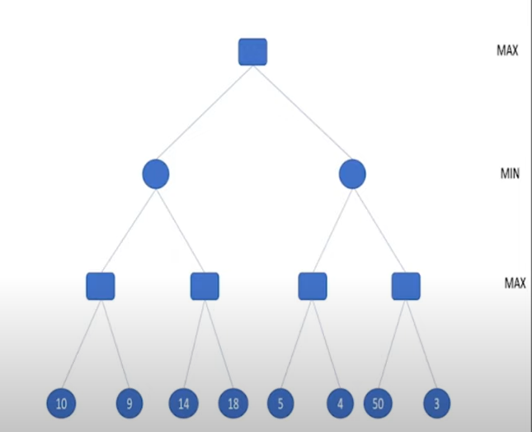
Algorithm
Generate the whole game tree
Apply utility function to leaves
Uses DFS for expanding the tree
Backup values from the leaves toward the root
a max node takes the maximum value from its child node
a min node takes the minimum value from its child node

Slide 5
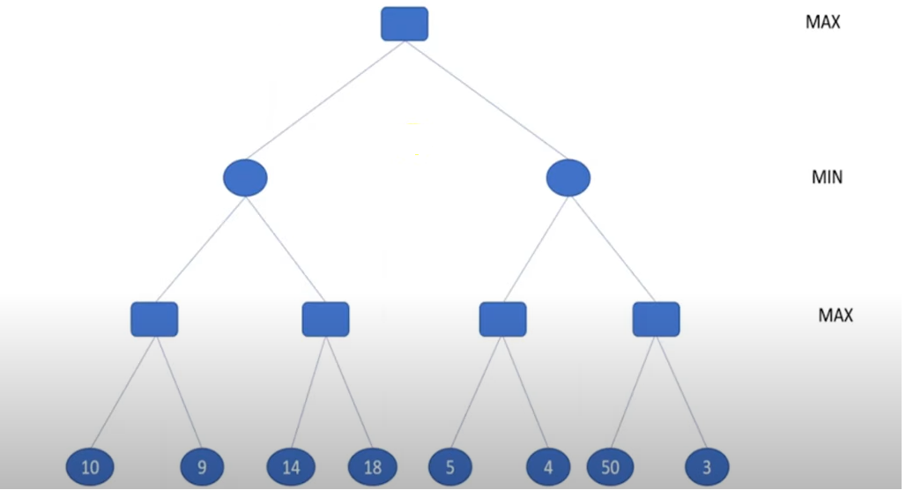
Example 1

Slide 6
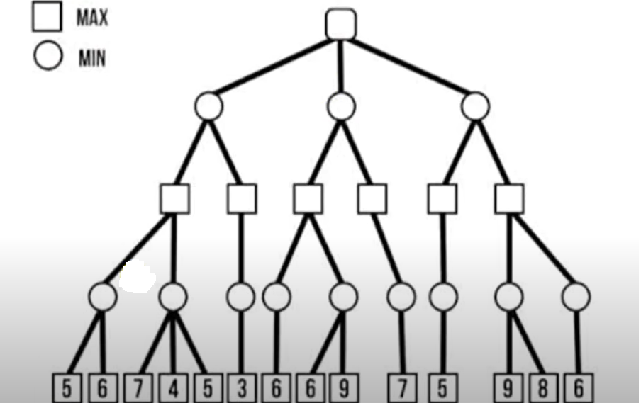
Example 2

Slide 7
Alpha Beta Pruning
Alpha Beta pruning helps to find the optimal path without looking at every node in the game tree.
Max contains the alpha (α)and min contains the beta (β)bound during the calculation.
Both MinMax and Alpha (α) and Beta (β) algorithm gives the same path as the solution.
But Alpha (α) and Beta (β) gives optimal solution as it takes less time to get value for the root node.

Slide 8
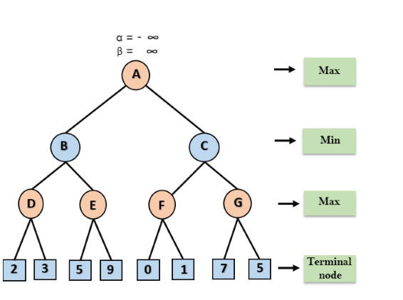
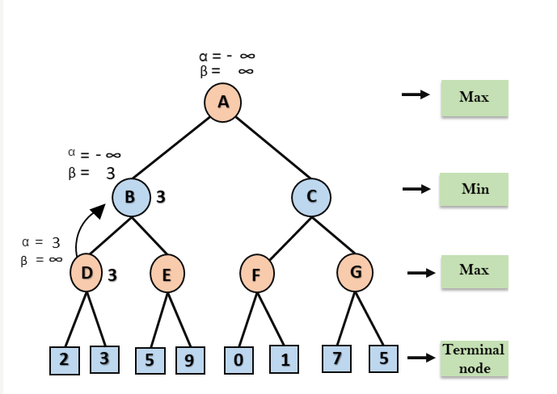
Example 1

Slide 9
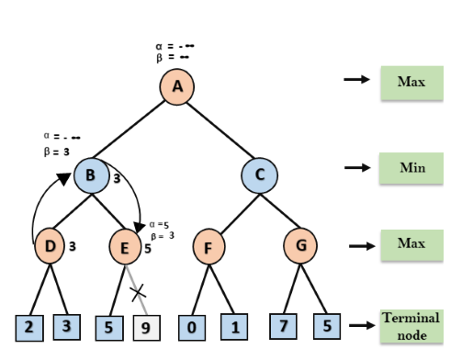
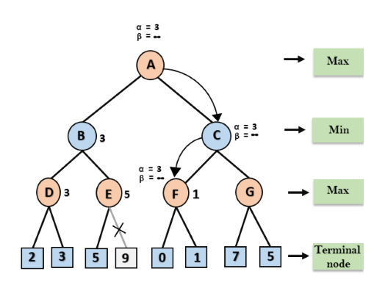

Slide 10
